Slide 1
Automating Desktop Apps With Appium & WebDriver
Selenium Conference 2017 Austin, TX
Dan Cuellar, Yosef Durr & Stuart Russell

Slide 2
In The Beginning

Slide 3
TimeLine
Websites – 2004
Selenium
WebDriver
Mobile Apps – 2011
Appium
Desktop Apps – 2014
WinAppDriver
Appium for Mac

Slide 4
THE Star-Driver VISION
One protocol to automate everything
Continue generalizing the WebDriver specification
Vendors will bring their own implementations of the protocol

Slide 5
Yosef Durr Senior Lead Program Manager

Slide 6
WINAPPDRIVER
Embracing the Appium/Selenium architecture
Open standards are required to enable the productivity we all desire
Developed WinAppDriver for PC with this vision in mind
Embracing the StarDriver vision
One protocol to test all the things
WinAppDriver for PC is the first but not last device for WinAppDriver

Slide 7
DEMO
WinAppDriver

Slide 8
WinAppDriver Today
Integrated with Appium
Works with the grid
C# .Net Driver includes a Windows class
Works with many languages and test runners
Multiple ways to query for elements
Xpath, AutomationID, Name, etc.
Almost out of Beta
A few API needs and perf\bugs we need to address first

Slide 9
Lessons Learned
Multiple Windows
Interaction with system Windows
Interaction with popups
Current support is not ideal: Can require creating a “root” session.

Slide 10
Lessons Learned
New devices and input types bring new problems opportunities
Multi touch, Pen, Dial
Voice
Mixing inputs at same time
HoloLens

Slide 11
Roadmap
PC fully featured
Appium Desktop integration
Pen, Touch
Mobile, Xbox
The Open Source Question

Slide 12
More Info
github.com/Microsoft/WinAppDriver
@yosefdurr

Slide 13


Slide 14
Stuart Russell Senior Software Engineer

Slide 15
Appium for Mac – overview
AppiumForMac.app / macOS

Slide 16

Appium for Mac – overview
Proof of concept for
automating a macOS app
with the JSON wire
protocol
2013

Slide 17
Appium for Mac – a WebDriver perspective
WebDriver Client sends HTTP request and waits
WebDriver Server takes action
and responds
JSON
wire protocol
(HTTP REST API)

Slide 18
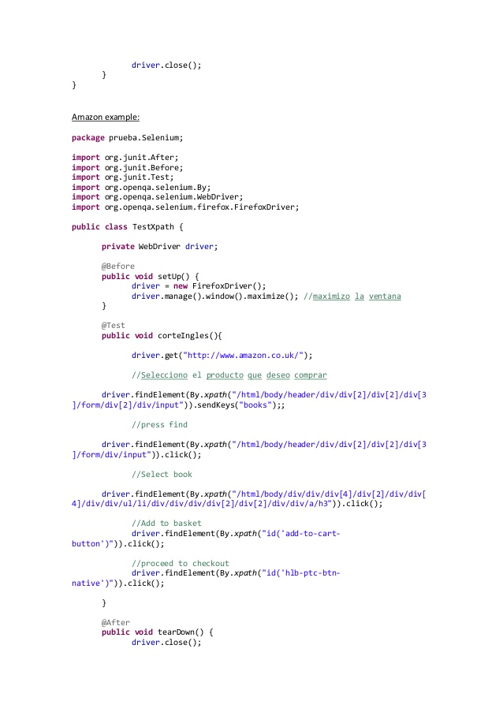
Appium for Mac – a WebDriver perspective
WebDriver Server takes action
and responds
JSON
wire protocol

Slide 19
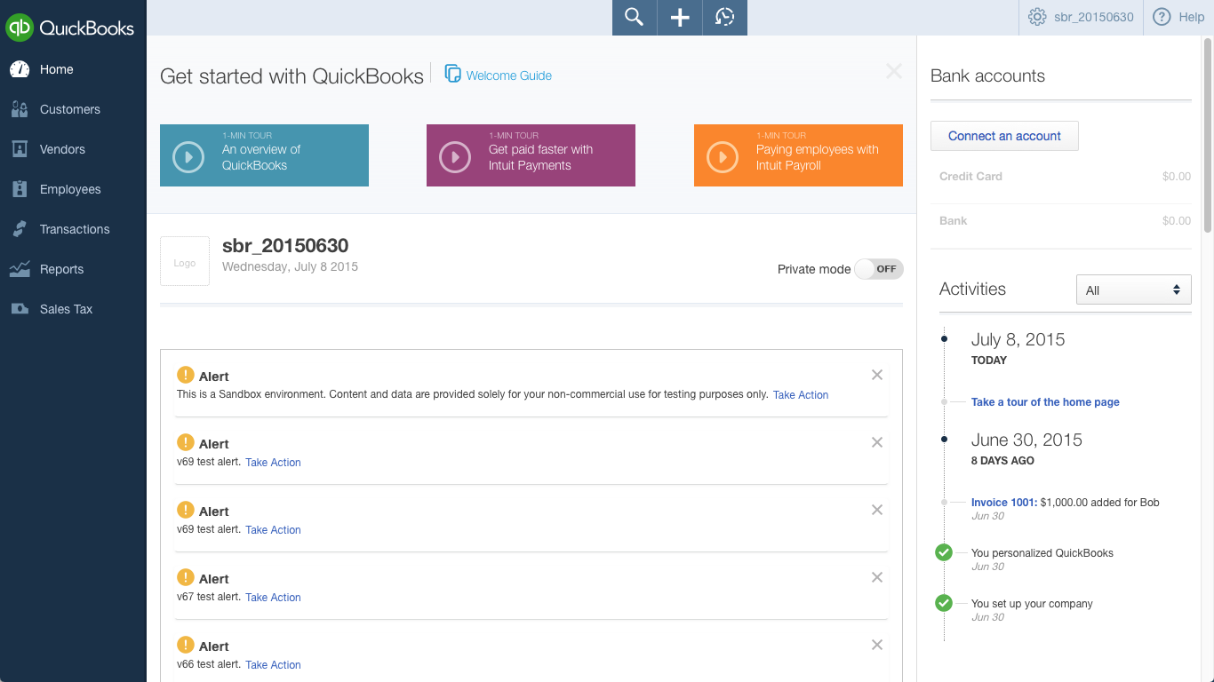
Appium for Mac – a WebDriver perspective
JSON
wire protocol

Slide 20

Appium for Mac – a WebDriver perspective
JSON
wire protocol

Slide 21
Appium for Mac – a WebDriver perspective
JSON
wire protocol

Slide 22
Appium for Mac – You can’t get there from here
X
JSON
wire protocol
X

Slide 23

Appium for Mac – a look inside
CocoaHTTPServer
PFAssistive
Framework
macOS
Accessibility
API
JSON
wire
protocol
WebDriver
command
handlers
macOS
mouse/kbd
API

Slide 24
DEMO
Appium for Mac – in action!

Slide 25
Questions?

Slide 26
More Info
Website: http://www.appium.io
Forum: discuss.appium.io
http://www.github.com/appium/appium
http://www.github.com/appium/appium-for-mac
http://www.github.com/microsoft/winappdriver

Slide 27


